Slide 1
Ms. Turner’s first grade
2019-2020

Slide 2
About me
I have been at Rolling Meadows since 2009 and I love it! I am so lucky to work with such wonderful students, parents, teachers and staff. I love Harry Potter, BYU Football, bright colors, chocolate, reading, traveling, music, dance, all things French, and spending time with my family and friends. I graduated from BYU with my Bachelor’s Degree and from Utah State with my Master’s Degree. I have always loved to learn new things and have wanted to be a teacher for as long as I can remember. I hope to be able to make this year not only one full of learning, but full of music, movement, fun and growing.

Slide 3
Daily schedule
Here is an overview of what a typical day may look like: 9:00-9:05 – Student Arrival and Breakfast Pickup 9:05-9:20 – Breakfast, self-start, and homework check 9:20-9:30 – Morning Meeting 9:30-10:30 – Language Arts Step-Up! 10:35-10:50 – A.M. Recess 10:50-11:30 – Math 11:30-12:00 – Language Arts 12:00-12:40 – Lunch and Recess 12:40-1:05 – Language Arts continued 1:05-1:50 – Extras 1:55-2:10 – P.M. Recess 2:10-3:00 – Workshops 3:00-3:35 – Science or Social Studies 3:35-3:45 – Review the day and Clean Up

Slide 4
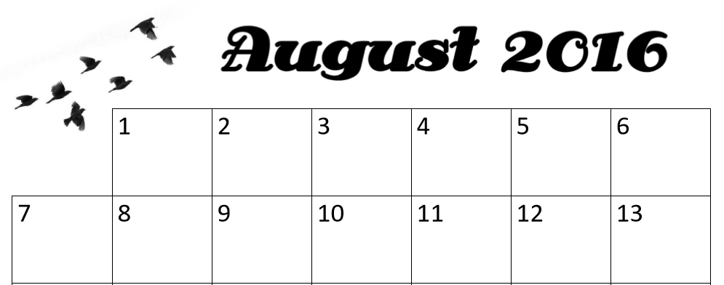
Homework
Homework Folders are to be taken home each night and returned the following day.
There will be a math homework page most Mondays-Thrusday (the exceptions being when a new unit is introduced or a test was taken). Students are also expected to read, and record their reading, at least 20 minutes each night. Reading minutes must be initialed by a parent or guardian.
20JS
20JS
20JS
20JS
20JS
20JS
20JS
20JS

Slide 5
curriculum
We follow the Utah State Core Curriculum (find it at www.uen.org). To help us reach our educational goals, we use Wonders reading and Go Math!
Wonders and Go Math! both have online supports which students can use at home. Both can be accessed from portal.graniteschools.org by using your student’s district number (9……) and the password 123456 or the student number again.
Links to both these websites, as well as other online activities, are available from my website: learnexplorecreate.weebly.com

Slide 6
extras
Mondays: Library Tuesdays:P.E. – don’t forget to wear good shoes! Wednesdays: Computers Thursdays: Rotate between Art, Keyboarding, and Social Skills
Students will be using Chromebooks on a regular basis. Wednesdays will be the day that we will have a set time for computer use, focusing on STMath. As the year progresses, we will be using the Chromebooks more and more frequently for a variety of assignments, projects, and activities.

Slide 7
Other information
Attendance – Not only is it important for your student to be in school, it is important for them to be on time. School starts at 9:00! If they come after 9:05, they are tardy.
While attendance is important, please do not bring your student if they are sick. We all want to be healthy! Students will not be allowed to stay in from recess for health related reasons without a doctor’s note. Please make sure that they are appropriately dressed for the weather! If the weather is too wet or cold, the administration will call an indoor recess.
Dress Code – All tops must have at least 2 inch shoulder straps and shorts/skirts must reach the student’s fingertips. No inappropriate images or words are allowed on clothing. If students are violating the dress code, they may be asked to call home or be given another shirt to wear.
Free-and-Reduced Lunch – Don’t forget to apply for free-and-reduced lunch!

Slide 8
Behavior Plan
This year first grade will be using CLASS DOJO. Please take a moment to download the CLASS DOJO APP and follow the instructions to join our class (sent home separately). At Rolling Meadows we expect Rockets to ROCK! They need to be Respectful, On Task, Caring, and keep Kyhfooty. Students will be able to receive (and be deducted) points from any first grade teacher. Classroom goals will be set leading up to various celebrations. What it takes to participate in each celebration will vary throughout the year as we adjust to the needs of the kids and work together to discover how to best use this application.
Days with substitutes a clip chart will be used to determine how many points they will receive: Purple +3, Pink +2, Blue +1, Green +0, Yellow -1, Orange -2, Red -3
To start off the year, students may EARN points for the following: Individually Bringing homework and signed reading log each day, Setting an example as a student who ROCKs! (this will be broken down into several elements) and Showing growth toward, or meeting, an individual goal. As A Class Following directions the first time, Being ready to enter the school when picked up from recess, Being recognized by another school worker for their example, and Receiving positive feedback from a Substitute Teacher. | Students will LOSE points for the following: Individually Not coming to school prepared, or Breaking a school expectation (these expectations will be listed separately). As A Class Negative feedback from a Substitute Teacher.

